Slide 1
The Electronic Dispensing Tool ART Processes
Presented by: Samson Mwinga
Snr. MIS Advisor
MSH/SIAPS

Slide 2
About The e-Dispensing tool
The Electronic Dispensing Tool (EDT)
A Microsoft Access 2010 software program running on Microsoft SQL Server 2008R2 database engine.
Used by the Namibia ART Programme to collect and manage pharmacy related data of patients on ART.
Currently in use at 50 public health facilities countrywide, including hospitals, health centres and clinics.
Has its mobile version - The EDT Mobile - which extends its reach to other primary health care facilities providing ART services.
Introduction

Slide 3
About The Course
This course introduces you to
A process-based hands-on approach to using the Electronic Dispensing Tool
EDT Processes will help you to
Easily learn how to use the EDT
Improve consistency in the way you use the tool while providing ART services
Appreciate the importance of data collection when generating EDT reports that quickly highlight how your patients are doing and how well you are managing your antiretroviral medicines (ARVs)
Introduction

Slide 4
Definition of Terms
Patients Statuses
Lost Status - 30 days after missed Pharmacy appointment.
Loss To Follow Up Status (LTFU) - 90 days after missed Pharmacy appointment.
Main site
An ART services providing hospital, health centre or clinic with its own EDT computer.
Peripheral site
A neighbouring site (i.e. health centre or clinic), that does not have an EDT computer.
Introduction

Slide 5
Goals of the Training
After completing this course you will be able to:
Manage patients at main sites using the EDT
Manage ARV stock at main site using the EDT
Manage patients at peripheral sites using the EDT Mobile
Generate and use EDT Reports for ART Reporting
Use the EDT toolset to improve ART service delivery at public health facilities
Introduction

Slide 6
Using the EDT to improve ART service delivery
Patient Management at main site using the EDT
Entering patients on ART from other sites
Stock Management at main site using the EDT
Main site ART processes
Patient Management at peripheral site using the EDT Mobile
ART Reporting and Data Quality using EDT reports
Stopping patient management on the EDT
Updating patient data
Recording stock take details
Peripheral site ART Process flow
Dispensing to patients
Main site ART processes
Recruitment of new patients initiating ART
Reversing a transaction
Managing patient appointments
Receiving and Issuing of stock from the EDT
Quantification of ARVs
Preparing stock for peripheral site
Peripheral site ART Processes
Preparing the EDT Mobile
Dispensing
ART recruitment
Facility, regional, and national level
Using predfined EDT reports
Monitoring patient adherence to ART
Completing the ART Monthly Reporting Template at the main site
Improving EDT Data quality
ART Data abstraction, validation and use
Updating the main site
Introduction

Slide 7
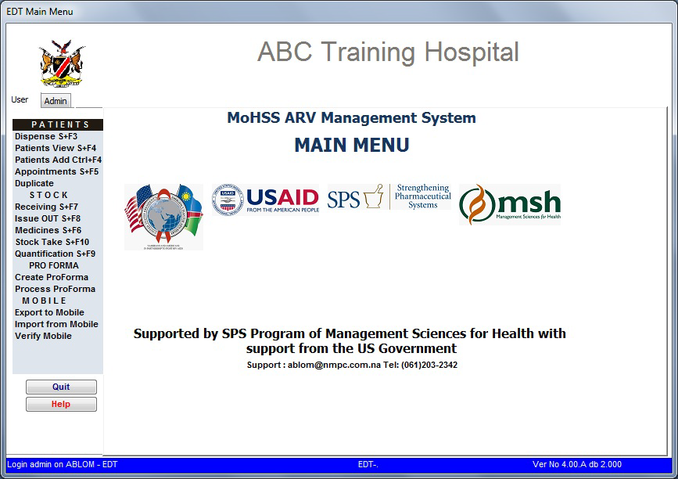
Getting Started
The Electronic Dispensing Tool

Slide 8
Overview of the EDT
By the end of this session, you will be able to:
List the components of the EDT toolset
Login to the EDT system
Understand the importance of the EDT start-up process
List the do’s and don’ts related to the EDT system
List the main functions of the EDT desktop application
Getting Started

Slide 9
Overview of the EDT
The EDT toolset comprises:
The EDT desktop application (the main tool)
EDT Reports desktop application (for generating reports)
EDT Mobile (data collection terminal)
EDT Printer (for printing medicine labels)
ART national database (NDB)
EDT 3G dongles (for electronic data transfer to the NDB)
Getting Started

Slide 10
Overview of the EDT
Additional tools used with the EDT toolset:
ART Monthly Reporting Template
ART Recruitment Form (for peripheral sites)
ARV Medicines Codes Leaflet
Medicines Leaflet for Stock Taking
Patient’s File (Patient Care Booklet)
Patient’s Passport
Getting Started

Slide 11
Overview of the EDT
The EDT Start-up Process:
Stock Take Reminder
Automatic status changes:
Active to Lost: patient missed appointment by more than 30 days
Lost to LTFU: patient missed appointment by more than 90 days
Transferred-in to Active: patient transferred in 30 days ago (one month)
Restarted to Active: patient restarted 30 days ago (one month)
Note: delayed status changes constitute a measurable indicator that the EDT system is not being optimally used…
Getting Started

Slide 12
Overview of the EDT
Guidelines for getting the best out of the EDT:
Do’s
Ensure that the unique number is entered on the EDT when starting or managing patients
Before you dispense always make sure the date of visit is accurate
Reverse the full dispensing done rather than dispensing the difference
If you have to work during lunch hours, use the EDT Mobile
Don’ts
Do not change the EDT computer’s system time. This might corrupt your database.
Do not enter in-transit patients as NEW patients on your EDT system.
Do not use the EDT computer during lunch hours, use the EDT Mobile instead
Getting Started

Slide 13
The main functions of the EDT
Patient Management
Dispense: used to dispense to existing patients and automatically calculate adherence by pill count
Patient View: used to manage existing patients
Patient Add: used to add new, transferred-in or in-transit patient
Appointments: used to manage patient appointments
Overview of the EDT

Slide 14
The main functions of the EDT
Stock/Medicines Management
Receiving stock: used to receive medicines into the system
Issuing stock: used to issue medicines to other sites
Medicines: view medicine details including dispensing, receiving, stock-take history, and quantification
Stock Take: used during stock taking to update stock levels
Quantification: view the recommended re-order quantities based on consumption
Overview of the EDT

Slide 15
The main functions of the EDT
Export/Import from the EDT Mobile
Creating files and sending them to the EDT Mobile
Receiving/importing files from the EDT Mobile
Verifying imported data
Overview of the EDT

Slide 16
Practical session
Familiarisation with the EDT
Login
Browse through the EDT menus
Thank you.
Overview of the EDT

Slide 17
Patient Management at Main Site
The Electronic Dispensing Tool ART Processes

Slide 18
Entering Patients into the System .
New on ART
Required: Patient Care Booklet (PCB)
Use case:
Patients being initiated on ART, including pregnant women on PMTCT Option B+
On the EDT:
Click Patient Add, leave Status as Active, enter Unique#, fill in all required details and save
For pregnant women, make sure to mark the pregnancy status and include the expected delivery date.
Enter the newly assigned EDT ART# in the PCB and passport (i.e. note it down or stick a tracer label)
Patient Management at Main Site

Slide 19
Entering Patients into the System .
Other Patients
Required:
Transfer-In: PCB or Transfer Letter from previous ART site
In-Transit: Patient’s previous prescription on health passport
Use case:
Patients transferred-in or in-transit
On the EDT:
Click Patient Add, set status to Transferred-In or In-Transit, enter existing EDT ART# &Unique#, fill in all required details & save
If the EDT ART# is missing and cannot be found, follow instructions in the next slide
Patient Management at Main Site

Slide 20
Entering Patients into the System .
Assigning a new EDT ART#
Use case:
Patient from another site without an EDT ART#
Patient transferred in from private sector or coming from abroad
On the EDT:
Do not add these patients as new, but rather follow the process of adding them as transfer-ins or in-transit.
The EDT will auto-generate the new EDT ART#
e.g. 2100-11 – meaning patient is from private sector (2) coming to Katima Mulilo (100) and is the 11th patient. N can be one of the following: 1=public sector; 2=private sector; 3=abroad.
Patient Management at Main Site

Slide 21
Key notes to remember:
For pregnant women being initiated on ART, leave the status field as Active and specify their pregnancy status and expected date of delivery.
Ensure the ART# is in the PCB and passport
Use of patient’s care booklet ensures conformity with the ePMS data and enables more complete capturing of information
Entering patient’s information based on the patient’s verbal info is not recommended as some information may be missed out or incorrect information provided inadvertently
Capturing the Unique Number from the patient’s care booklet facilitates future data quality assessments against the ePMS as well as research studies
Patient Management at Main Site

